Slide 1
Unit 1 -
Object Oriented Programming
CS 102

Slide 2
Go online and research “Object Oriented Programming” and be ready to describe what is in your own words

Slide 3
Object Oriented Programming - OOP
An extremely common question that you will get during a job interview is “explain object oriented programming in your own words”
“Object oriented programming is a way of coding that allows you to create objects with properties that are cloned when you reference that object, so you don’t have to type something over and over and over…”

Slide 4
OOP Vocab
Encapsulation
The ability to store information inside of an object so that it is only visible to the object
Abstraction
Hiding the internal mechanisms behind a simple interface

Slide 5
Create 2 real world examples that explain Encapsulation
And
2 real world examples that explain Abstraction

Slide 6
OOP Vocab
Inheritance
Basing one object off another in order to retain similar implementation or properties
Polymorphism
The ability to perform the same action in different ways (i.e. run() can be 2 legs or 4 legs)

Slide 7
Create 2 real world examples that explain Inheritance
And
2 real world examples that explain Polymorphism

Slide 9
Objects and Object Methods

Slide 10
What is an Object
An object (sometimes referred to as a class in other languages) is a data type just like strings and numbers but unlike those “primitive” data types they are used to store many values at once using keyed collections and more complex entries.

Slide 11
How to think about an object
An object is like a wallet that stores all kinds of things. You may have a card, that card is an ID or a debit card. You can have money which may be a single or a five. You can even use it to store things normally wouldn’t go in a wallet, like lint or paper clips.
In this example the wallet object is holding a card key with an ID value. Etc...

Slide 12
How To Create An Object
An empty object is created using either an object constructor or an object literal
let wallet = new Object();
This is an object constructor
let wallet = {};
This is an object literal

Slide 13
Key:Value aka Properties
In order to save values in an object you need to assign them a key, kind of like a name tag that you can refer to later to “get” the value back out. It is written like
card: "Debit",
cash: 42
Every key:value is seperated with a “ , ” and the key and value pair is seperated with a colon

Slide 14
Assigning Values To Your Object
Now we combine those two things and we end up with an object that is holding keys and values
let wallet = {
card: "Debit",
cash: 42
};

Slide 15
Create a student object that has the properties for
Name, ID, hair color, favorite snack, which class you are taking at west-mec, and the session time that you in (1:00 or 4:00)

Slide 16
Reading Your Properties
In the wallet object that we made we can add, remove and read any of the properties at any time
The values are called by using the properties and keys that we defined.
console.log(wallet.card);
// Debit
console.log(wallet.cash);
// 42

Slide 17
Adding New Properties
Just because a key was not added at creation does not mean that we can’t add it later.
We can also add new properties similar to how we took the value out.
wallet.ID = "School ID"
console.log(wallet.ID)
//School ID;

Slide 18
Removing Properties
Sometimes a card will expire, or be lost, or you will spend all your cash.
When this happens the property will need to be removed from the object.
delete wallet.cash;
Rather than making the value 0 we can remove it entirely, sometimes this is preferable

Slide 19
Multiword Properties
You may also use multi word properties
The benefit is being able to express more complicated keys or to have a value that works easier with something a person would read.
This is very useful when creating databases or tables

Slide 20
Square Brackets
We can’t add something like
wallet.is poor = true
This will break the code as well
wallet."is poor" = true
When creating multi word properties we need use square brackets
wallet["is poor"] = true
console.log(wallet["is poor"]);

Slide 21
Adding Through Prompts
Most likely you will not want to fill out an entire object on your own, the code can do that for you.
let wallet = {}
let money = prompt("how much do you want to take out", "20");
wallet["cash"] = money;

Slide 22
Create a short bit of code that will prompt a user to enter their name, fav color, and a random number they are thinking of. Store all of those values in an object of your choice

Slide 23
Functions to Initialize/Clone
Many times when you want to create a new object you will pass it through a function.
This is best done by using key:value pairs with the same name and then passing the values through the parameters.

Slide 24
Functions to Initialize/Clone
function createStudent(name, id) {
return {
name: name,
id: id
};
}
let jimmy = createStudent("Jimmy X.", 123456);
console.log(jimmy.name); // Jimmy X.

Slide 25
Shorthand
This kind of function is so commonly used that there is shorthand for creating it.
If you omit the key then it will make the key and value the same.
function createStudent(name, id) {
return {
name,
id
};
}

Slide 26
Update the code for the student object that you made before. Change it so that it is no longer a prompt but is instead a function that has the inputs in the parameters

Slide 27
The “in” Operator
You should always check to make sure that a key is in an object before calling it.
In order to do this we can use the in operator to check the key.
"key" in object; //true or false
For example:
"cash" in wallet; //false, if there is no cash in the wallet

Slide 28
The “for… in” loop
If you have an object that is filled with several properties that you would like to extract you may use a for in loop
for(let key in wallet){
console.log(key); //card, cash
console.log(wallet[key]);//"debit", 42
}

Slide 29
Ordering in an Object
When you have a lot of numbers for keys in your object they will always be ordered least to greatest.
let list = {
5: 4,
10: 3,
2: 8,
1: 1,
}
console.log(list);
'1': 1,
'2': 8,
'5': 4,
'10': 3

Slide 30
Stopping Ordering in an Object
By adding a “+” in front of your number you can stop the object from auto ordering your properties.
let list = {
+5: 4,
+10: 3,
+2: 8,
+1: 1,
}
console.log(list);
'5': 4,
'10': 3,
'2': 8,
'1': 1

Slide 31
Create a short website, HTML, and JS included. No fancy style needed but it will have 4 input boxes. The value in the boxes will be passed to an object that will store all of it in a nice way and output the object to the console. You choose the topic you for the object and questions

Slide 32
Object Referencing
When you have a variable and you copy that variable into a new name then the value is copied and restored
Objects instead only copy the reference or address to where the value is being stored.
Therefore if you two objects pointing to the same value, modifying one will modify both of them.

Slide 33
Variable Referencing
let first = 20;
let second = first;
first = 10;
console.log(first); // ??
console.log(second); // ??
let first = 20;
let second = first;
first = 10;
console.log(first); //10
console.log(second); //20

Slide 34
Object Referencing
let first = {cash: 20};
let second = first;
first.cash = 10;
console.log(first.cash); // ??
console.log(second.cash); // ??
let first = {cash: 20};
let second = first;
first.cash = 10;
console.log(first.cash); // 10
console.log(second.cash); // 10

Slide 35
Object Cloning
I have shown you before how to create a new object using a function but now I will show you how clone an object like we do with a variable.
This is tricky since normally when we assign an object to an object we create a dependent clone

Slide 36
Object.assign
You can place any object into another creating a brand new independent object by using Object.assign
Object.assign(destination, source1, source2, moreSources);

Slide 37
Object Methods
We don’t just have to add variables and objects to other objects, but we can also add functions.
When a function expression is added to an object as a property we call this a method

Slide 38
Method Shorthand
user = {
sayHi: function () {
alert("Hello");
}
};
User is an object and sayHi is the key associated with the function that will say hello.

Slide 39
Method Shorthand
user = {
sayHi() { // same as "sayHi: function()"
alert("Hello");
}
};
This is the same as the last slide but written in shorthand.
Either way is fine, use the one that make the most sense to you

Slide 40
this. Method
When using methods in an object it is usually required to use some value from inside of the object.
Since the object can be cloned or the method can be moved to another its best to tell the method to use whatever object that the method is in.
We do that with this.key

Slide 41
this. Method
let user = {
name: "John",
age: 30,
sayHi() {
// "this" is the "current object"
alert(this.name);
}
};
user.sayHi(); // John

Slide 42
let calculator = {
// ... your code ...
};
calculator.read(); //prompts for 2 values and saves them as objects
alert(calculator.sum());//returns the sum of the 2 values
alert(calculator.mul()); //returns the product of the 2 values

Slide 43
let ladder = {
//... your code...
};
ladder.up(); //go up one step
ladder.up();
ladder.down(); //go down 1 step
ladder.showStep(); //show what step you are on. 1 in this case

Slide 44
We are going to update the last object in 2 ways.
You are going to make is chainable, as shown below
Add a way to define the max steps on the ladder when the ladder object is created
ladder.height(5) //will not increase passed 5
ladder.up().up().down().up().down().showStep(); // 1

Slide 45
Constructor Functions
A constructor function is a normal function that is used to create an object as many times as we want.
function User(name, id){
this.name = name;
this.id = id;
this.admin = false;
}

Slide 46
Constructor Functions
There are 2 conventions that make constructor functions stand out from a regular function
They have a capital first letter
They are only executed with the “new” operator

Slide 47
Using the “new” Operator
From the constructor function we made earlier we can now create any user object we want.
let tommy = new User("Tom", 12345);
console.log(tommy.name); //'Tom'
console.log(tommy.id); //12345
console.log(tommy.admin);//false

Slide 48
Create a constructor function that will be named student
It will store a full name
An ID value
A grade level
Current grade
It will auto set “permissions” key to “Student

Slide 49
Add 3 methods to the student object:
graduate( ) - this will increase the grade level +1
whiteList( ) - this will change the permissions to admin
setGrade(value) - change the current to value

Slide 50
Classes and Class Syntax

Slide 51
What is a class?
A class is essentially a function that provides better uses for constructing objects with values and methods.

Slide 52
Proper “class” Syntax
class MyClass {
constructor(){
//default values
}
method1(){}
method2(){}
method3(){}
}

Slide 53
Proper “class” Syntax
Just as before the name of the constructor functions (the class) should start with a capital letter.
For a class the first method that you create should be the “constructor” method.
Also you don’t need commas to separate your methods

Slide 54
Constructor Method
The constructor method is the first function called when creating an object with the “new” keyword
If you do not define the constructor method it will still happen but it will be an empty method.

Slide 55
Example Class
class Student {
constructor(name, id, gradeLevel){
this.name = name;
this.id = id;
this.gradeLevel = gradeLevel;
this.perm = "Student";
}
checkPerm(){
console.log(`the permission is ${this.perm}`);
}
}

Slide 56
Getter and Setter Properties
You can add “get” to any of your methods to make sure that they can not be used to change a value.
You can use “set” if you want to create a method that is only used to update values.
The benefit of these is that they stop users/coders from using the methods incorrectly

Slide 57
Extending a Class
You can create “child classes” where they have all of the same properties of the parent class and then you can define more
I.e. if you have an animal class and you make a cat subclass.
They will share many properties with other animals but you can add a few that only cats have, like lives

Slide 58
Extending a Class
class Animal {
constructor(speed){
this.speed = speed;
}
run(){
distance += this.speed;
}
}
class Cat extends Animal {
lives(lives){
this.lives = lives
}
}

Slide 59
Extending a Function
You are allowed to extend any expression you want including function not just classes
This is not as common but sometimes you need to create a class using a function, now you can extend it

Slide 60
Extending a Function
function hello() {
return class {
sayHi(name) { console.log(`Hello ${name}`) }
}
}
class User extends hello() { }
new User().sayHi("Jimmy");

Slide 61
Super Methods
Normally we don’t want to overwrite a method when using it in a child class but we do want to modify it
To do this we use the super. keyword in order to refer to the parent class.

Slide 62
Code along with super keyword

Slide 63
Creating an updating list of objects code along

Slide 64
Date Object
The date object is a built in object that allows us to use time a bunch of different ways.
Normally we would need to create a ton of different methods to access the day or month or find the time between days, now don’t have to

Slide 65
New Date
We create new dates just like any other object
let date = new Date();
Inside of the parameters you have some options
Milliseconds
Datestring
Year, month, date, hours, minutes, seconds, ms
Only the year and month are required

Slide 66
Milliseconds
If you are putting in milliseconds it is calculated from Jan 1st of 1970 at midnight (0:00).
(days * hours * minutes * seconds * 1000)
let Jan02_1970 = new Date(1 * 24 * 60 * 60 * 1000);

Slide 67
Datestring
A string will be parsed automatically
let date = new Date("2021-01-20")
If the time is not set it is assumed to be midnight GMT and is adjusted according to timezone. For instance:
Thu Jan 20 2021 11:00:00 (Australia)
Wed Jan 19 2021 16:00:00 (California)

Slide 68
Year, month, date, ...
You can also create a date in the local time zone using just numbers.
Year, must be 4 digits
Month, starts at 0(Jan) and goes to 11(Dec)
Date, starts at 1
if left blank it is assumed 1
Hours, minutes, seconds, ms
All start at 0 and if they are left blank it is assumed 0

Slide 69
Date Methods
getFullYear()
Get the year in 4 digits
getMonth()
Get the month from 0 to 11
getDate()
Get the day of the month from 1 to 31
getHours, minutes, etc…
getDay()
Will return the day of the week 0(sun) to 6(sat)

Slide 70
Setting Date Components
You can also use all of the same methods with set instead
Look it up for more information.

Slide 71
Auto Correcting
The date object also auto corrects errors for you
let date = new Date(2013, 0, 32); // 32 Jan 2013 ?!?
alert(date); // ...is 1st Feb 2013!
This is often used to find a time that is x minutes from the old time.
let date = new Date();
date.setSeconds(date.getSeconds() + 70);
alert( date ); // shows the correct date

Slide 72
Date.now()
Date.now( )
This returns the current time on the device that you are using.
This is the same as saying new Date().getTime() but saves your computer from creating a new date object

Slide 73
Project Time
Given the HTML and CSS please create the JS to complete an updating form.
Creating an Updating Form

Slide 74
Event Listeners and Event Handlers

Slide 75
Events
An event is something happening on the page, normally this is caused by the user interacting with the page.
Every DOM node (elements/items) on the page generates all of these signals, normally they are just set to do nothing.

Slide 76
Event Listeners
In order to react to these signals we need to set up event listeners that will wait on the page until the event triggers it
We have been using one of them for a while now called onclick=""

Slide 77
Common Mouse Events
click
when the mouse is pressed and released on an element
contextmenu
When the mouse right-clicks on an element
mouseover/mouseout
When the mouse cursor moves over or leaves an element

Slide 78
Common Mouse Events
mousedown / mouseup
When the mouse button is pressed / released over an element
mousemove
When the mouse is moved

Slide 79
Common Keyboard Events
keydown
When the keyboard key is pressed
keyup
When the keyboard key is released

Slide 80
Common Form Element Events
Submit
When you hit the submit button in the form
Focus
When the user selects an element on the form e.g. an input box

Slide 81
Document / CSS Events
DOMContentLoaded
When the HTML is loaded and the DOM is fully built
Transitionend
When a CSS animation finishes

Slide 82
Event Handlers
Once a listener activates from the user interacting you have to tell it how to act.
A handler will tell the event listener what to do once it notices that the event has happened

Slide 83
Onclick Event Listener
<button id="submit" onclick="alert()">Submit</button>
<button id="submit">Submit</button>
<script>
submit.onclick = function(){
alert();
}
</script>

Slide 84
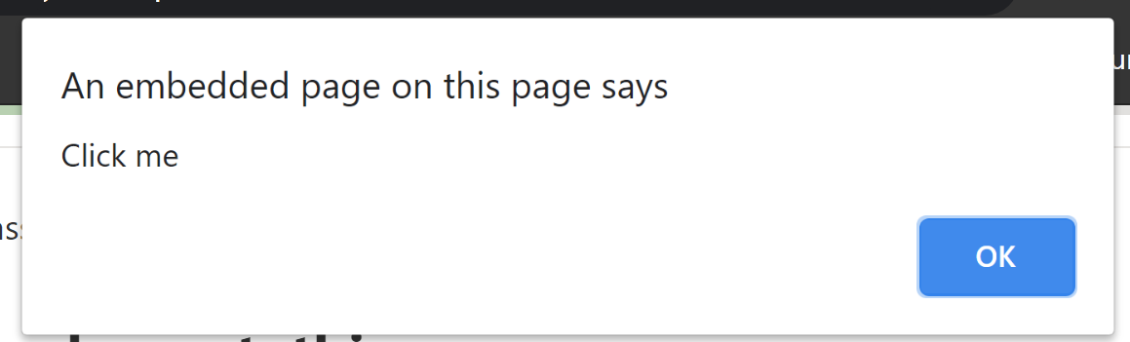
Using “this.”
You can use this and refer to the element that event is tied to, for example
<button onclick="alert(this.innerHTML)">Click me</button>

Slide 85
addEventListener
The old way of adding an event will not allow you to add more than 1 function per action.
Instead you should use :
elemID.addEventListener(event, handler, [options]);

Slide 86
removeEventListener
You can also remove any event listener you want by using:
elemID.removeEventListener(event, handler, [options]);
Since you may have more than 1 handler per event you will need to say the handler that you want to remove

Slide 87
More Shorthand
Since JS knows that the eventListener needs to be added to an element you can use shorthand and just say the id of the element without doing the jquery.

Slide 88
Shorthand Example HTML
<body>
<input type="button" id="elem" value="mic check">
<script src="script.js"></script>
</body>

Slide 89
Shorthand Example JS
function handler1() {
console.log("testing 1");
}
function handler2(){
console.log("testing 2");
}
elem.addEventListener("click", handler1);
elem.addEventListener("click", handler2);

Slide 90
Create 4 buttons. Using only eventListener and Handlers:
3 buttons should add a sound to the “song”
1 button will output the song to the HTML and clear the lyrics
E.g. “beep boop boop bop boop boop bop”

Slide 91
Event Object
When an event happens on your page the browser creates an event object that stores information about the event
For example: what kind of event, what it clicked on, and relative position

Slide 92
Event Object Properties
There are a lot of properties that you can use from the Event Object, here are a few
event.type
Will tell you what kind of action you are taking, right click, left click, etc.
event.currentTarget
What you are clicking on
event.clientX / event.clientY
Where you are clicking in px

Slide 93
Giving Multiple Events
You can make a switch case where you can have assign what should happen with each event
handleEvent(event) {
switch (event.type) {
case 'mousedown':
elem.innerText = "Mouse button pressed";
break;
case 'mouseup':
elem.innerText += "...and released.";
break;
}
}

Slide 94
Affecting the Styles
Using style.property on the current target element will allow you to change the property to whatever you want.
e.currentTarget.style.background = 'red'

Slide 95
Create a little bit of HTML and then create a button that will hide the text and bring it back, like turn it on and off.

Slide 96
Adding Events In A “for” Loop
If you want to create a large group of divs that all have event listeners you can add them with a loop, and save yourself some work.
There are a few new bits of code that you will need to know

Slide 97
Creating Elements
You can use the document object to make new elements, not just read the elements on it.
document.createElement("div")
document.createElement("li")

Slide 98
Appending Children
Once you have created and updated the element that you want to add to the html you can then take that element and add it to the HTML by appending child of the parent element
parent.appendChild(child);

Slide 99
Create, Add, Append, Repeat
for (let i = 0; i < 9; i++) {
let square = document.createElement("div");
square.addEventListener("mouseover", testing);
main.appendChild(square);
}

Slide 100
Create a 3x3 grid using loops.
Create an event listener and using the “this” keyword change the background color of the box when clicked on.

Slide 101
Transitions
There are a lot of different CSS animations that you can put on your work but the first one (and easiest one) that we are going to use it transition
Every time a property changes on your CSS the transition will show the change from one to the next

Slide 102
Transitions
Transition “all” will affect every kind of transition on that element
“1s” means it will take 1 second to cause that transition to happen
div{
transition: all 1s;
}

Slide 103
Update your grid so that:
The box will be red when the cursor is over it
go back to white when the cursor leaves
Turn green when you click
And does not turn back to white when you leave.
All of these should transition nicely

Slide 104
Custom Cursors
There are a few ways to make a custom cursor on the screen, we are going to learn the simple way for now.
The cursor property is a way that we can change what the cursor looks like.

Slide 105
Pixel Art
We can finally flex the pixel art skills,
Create a new canvas on pixler and make sure that it is 128px x 128px, this is the max size and anything larger wont load

Slide 106
Cursor Property
div{
cursor: url('cleat.png'), pointer;
}
This will only work on the selector that you chose

Slide 107
Finding the height and width
You can create an object with the exact pixels measurements of an HTML object using
this.getBoundingClientRect();
This is really helpful when trying to move an object around relative to another object

Slide 108
Finding Height and Width
If you want to use any pixel sizes on HTML objects on the screen you can use the following
field.clientHeight/Width
Find the height and width of the content box on the object
field.clientTop/Right/Bottom/Left
Find the pixel measure of the border on that corresponding side

Slide 109
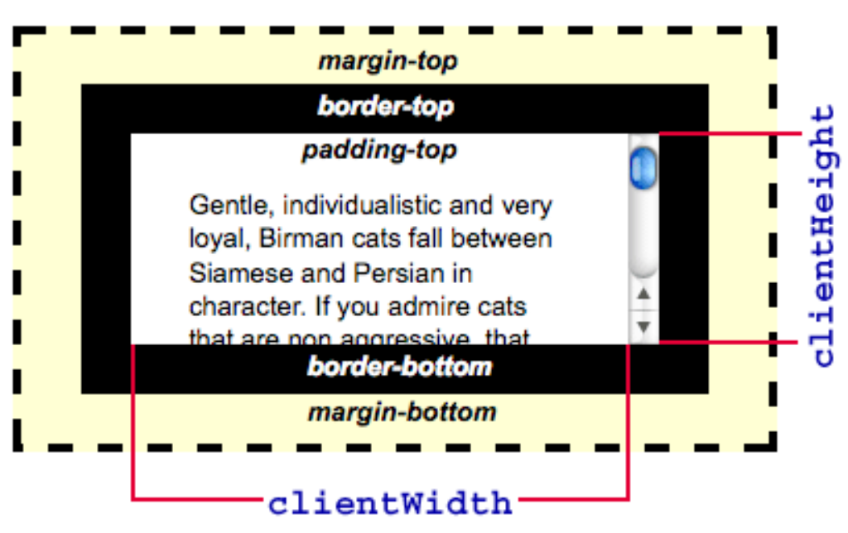
Examples

Slide 110
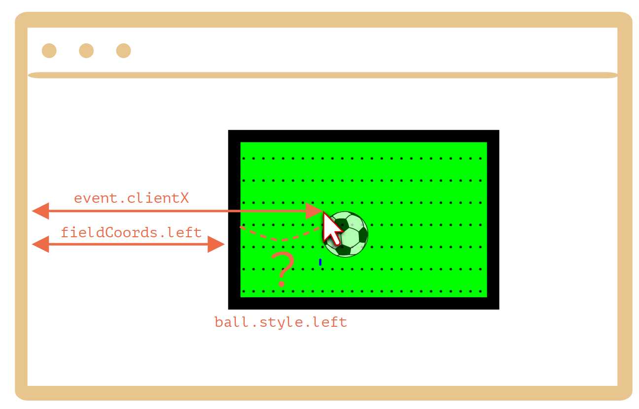
Examples

Slide 111
Code Along: Soccer Field

Slide 112
Project Time
Please read the requirements and then complete the project
Voting for Nixon

